Slide 2
Presentation Title
Le Tuan Hung l Agentic AI the next through of Generative AI
Notes:
Hi everyone, thank everyone to join here today, hope we are grateful time in here today. Personally, I am Hung, and today I want to bring a topic about
To see my picture overall about my topic, we will go through for main points

Slide 3
Agentic AI – The Next Breakthrough After GenAI
1. Why is there an explosion of AI ?
2. Why is GenAI not enough ?
3. The upgrade from GenAI to Agentic AI
4. Applications & Future of Agentic AI
5. Q&A
Notes:
Firstly, we are overview about why…AI, as we can see recently, many applications have appeared, why not many years ago ? And we will explore this together
Secondly, we are explore about the development of genAi and why is GENAI not enough
And the next we have the main content the upgrade from genAI to agentic AI
And finally, we see the applications and future of agentic AI, and agentic AI with amkor technology vietnam

Slide 4
Why is there an explosion of AI

Slide 5
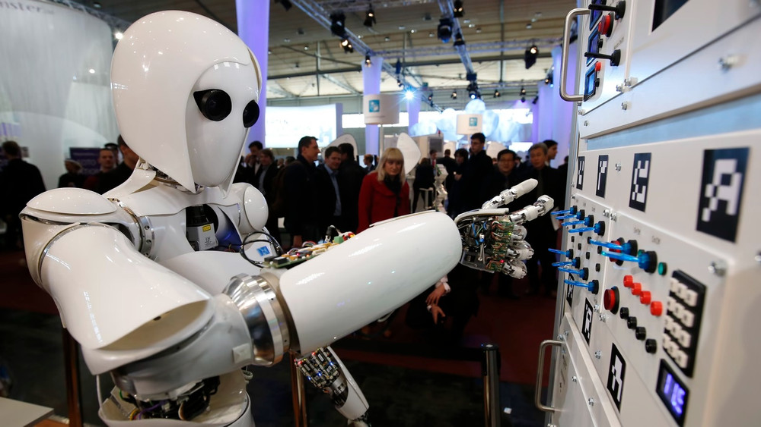
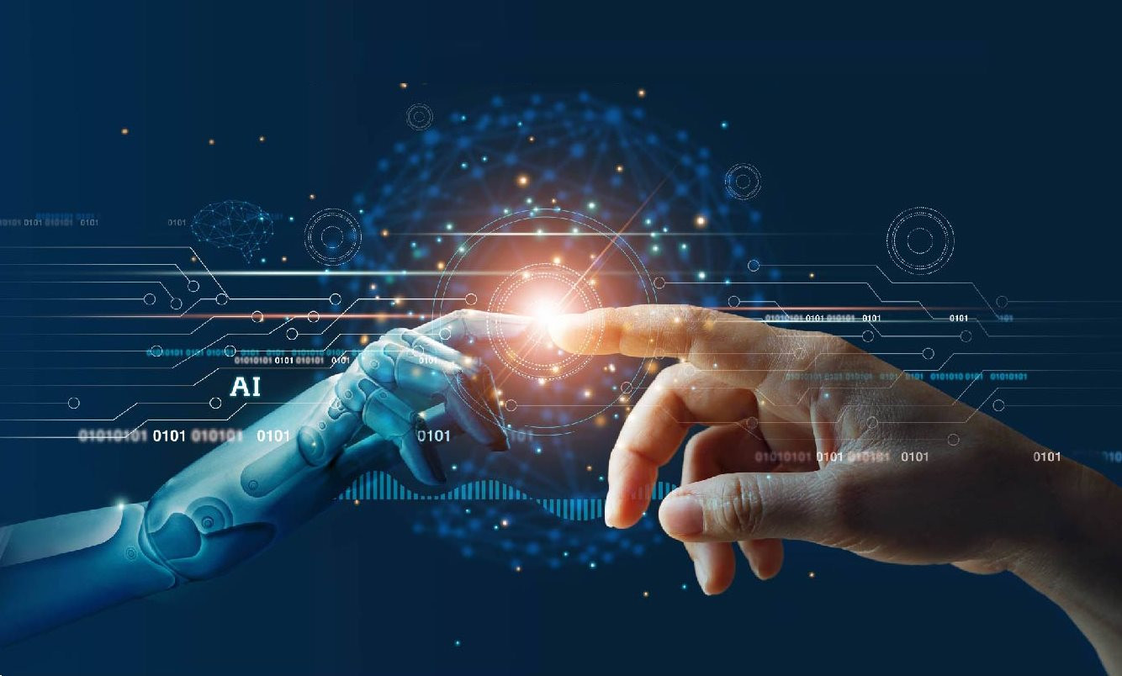
Why is there an explosion of AI
Before 2017
Can’t read big data from human
Read sequentially => Very low
Human language is very ironic
Example
I can’t fit the laptop into the bag because it’s too big
I can’t fit the laptop into the bag because it’s too small
Notes:
And we will comeback in 2017, the AI algorithm in this time can’t read….
Everyday human make many resources from audio, social, blog, and this data is unverified and very messy
The AI algorithm is this time read sequentially like a human read a book, it lead to execute time is very low
The human language is very ironic, why I said that we can see the classical example like this
We have two sentences, like the same but different from the last word big and small
But in the first sentence, you can see it representation for laptop, because laptop too big so I can’t fill in the bag
And the next sentence, it representation for the bag, so you can see AI can make a mistake when read sequentially

Slide 6
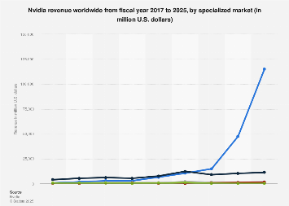
Why is there an explosion of AI
Transformer
Read the entire context
Find the relation between words
Undergoes multiple layers of analysis
Solve problems
Solving the data access problem
Need GPU process
NVIDIA explodes
All companies join, and that is the main reason explosion of AI
Notes:
And this a reason transformer architecture born and solve this problem
Instead of read sequentially, it read parallel, it read entire the context like a human, and combine with undergoes multiple layers of analysis to find the relation between words, and find the important word in the context
And with the transformer architecture, we can solve data access problem from human, and the most important thing in this time is increase execute time. All the companies realize this main point we just only increase execute time, all of big branches research, and this also remarked a explosion of AI
We can see nvidia’s revenue chart rising sharply.

Slide 7
Why is GenAI not enough

Slide 8
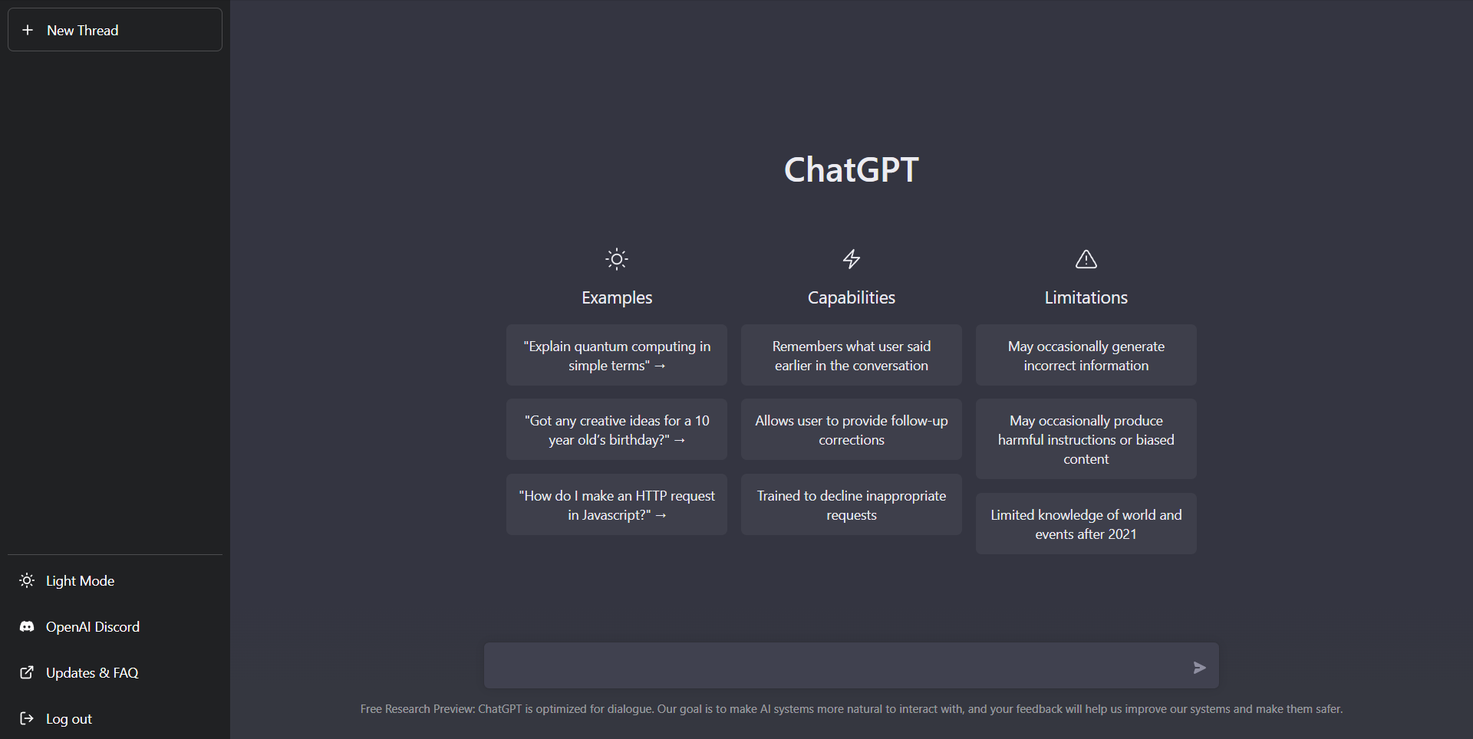
The development of GenAI
Generative AI
Predict words
Based on probability and from human context.
In 2022
Chat GPT was created
Chat interface, like a human
100 million users
Change the way learn and work
Notes:
Generative AI is essentially a word predictor; it doesn't understand human language.
It is based on statistical probabilities, relying on training to determine which answer has the highest probability from different contexts.
But after a long time to use AI, we realize some problems of AI like:

Slide 9
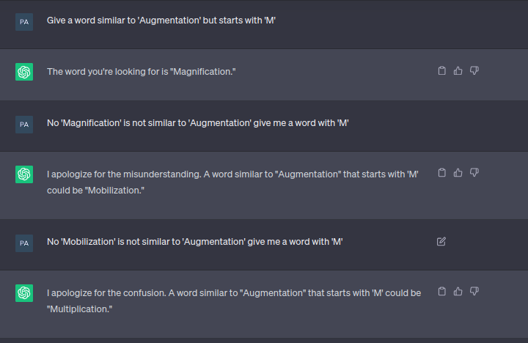
The problems of GenAI
Hallucination
Context window
Knowing, not doing
Notes:
Firstly is hallucination, there are many times, AI is try give the answer but it is wrong answer you can see the example
Secondly is context window, we have a project used for a long time, and have a day AI forget your context, and it answer hallucination, this actually is big problem

Slide 10
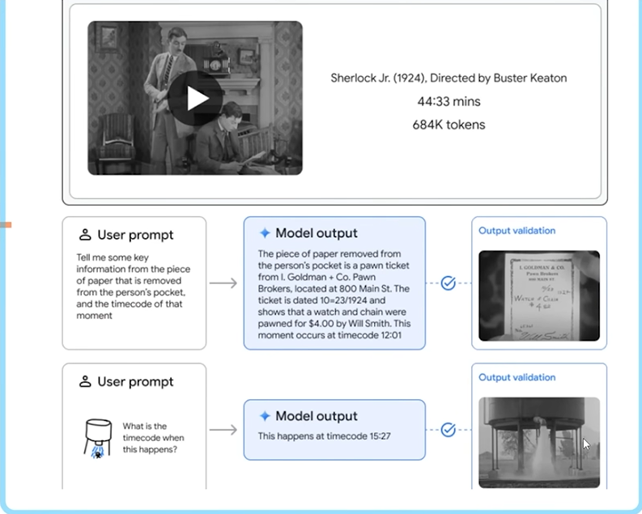
How to solve this problems
Many companies find solution
Google released Gemini 1.5
GenAI offers many things, but, it still needs human intervention
Agentic AI released
Notes:
Realize this problem, many company find the solution, and one of that is google, it released gemini 1.5 with ability is storage millions tokens, and as we can see the example in here, we have a vicdeo with a long time, and has 684 thousand tokens, and it completely handle this
As you can see the example with prompt a picture, it can show the timecode and picture appearance very fastly

Slide 11
The upgrade from GenAI to Agentic AI

Slide 12
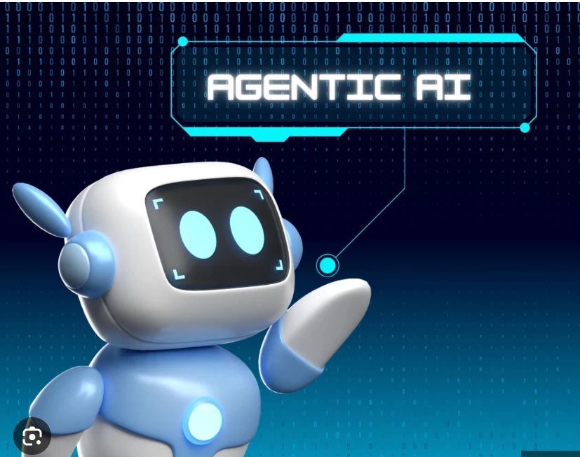
Agentic AI
Agentic AI
Goad-driven – understands and works toward objectives
Autonomous – acts without step-by-step instructions
Planning – creates and executes multi-step workflows
Adaptive – monitors progress and adjusts actions

Slide 13
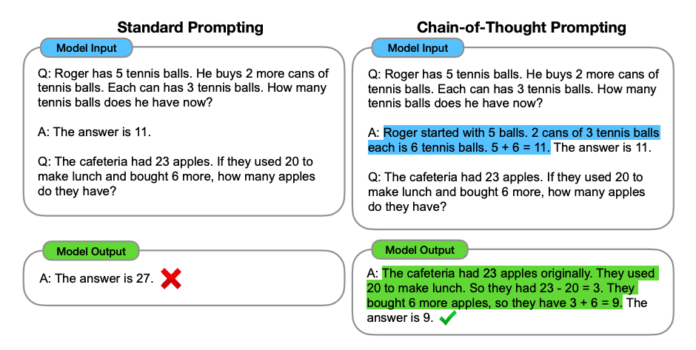
Agentic AI
Idea
Why LLM answer immediately ?
If we allow it “draft” before execute, what happen ?
Execution
Chain of Thought term
If we allow it “draft” before execute, what happen ?
Notes:
Agentic AI is agents that can active, interact. With the main idea, with generative AI, because the result sometime is incorrect, with the job have many steps, need to thinking, why allow it draft before execute
And the execution they do is chain of thought, to make a answer, let do step by step, they give a example to proof is it active effectively.

Slide 14
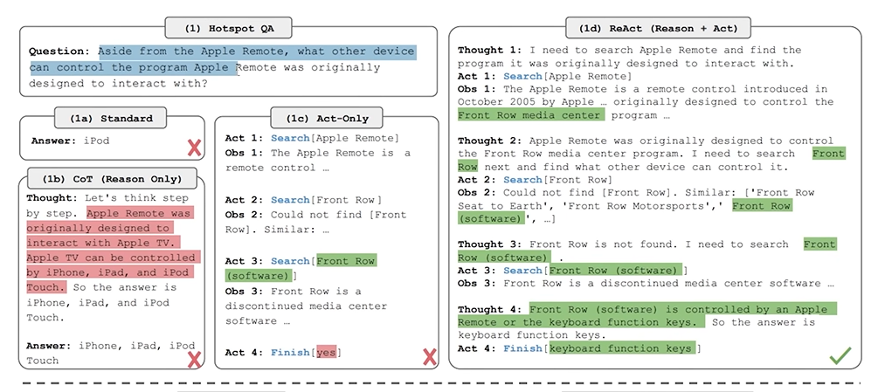
Agentic AI
Chain of thought (React – Reason + Act)
Notes:
If we put your AI a question and want to it answer immediately. Default answer, the advantage is fastly response but the disadvantage is wrong answer. And if apply cot, reason before act the result is still wrong. If only act, only search the rs is wrong. They realize that if we collaboration with reason before act, and see the result, the next step learn from previous step, we have correct answer.

Slide 15
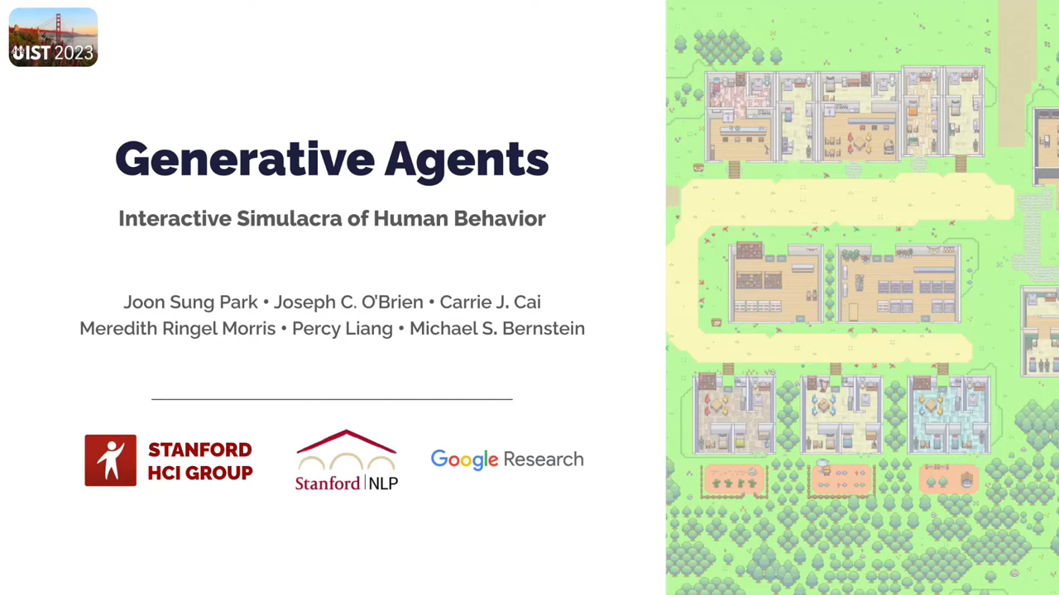
Smallville
With 25 AI agents interact, no script, each character is a unique individual
Notes:
We have a exciting event that a Smallville project from Stanford. In this article, this idea of project, it create 25 characters, 25 agents live in a village, and this game, and 25 characters created by 25 different personal, another one is haircut, father, and all of the agents don’t have script, each one has a LLM, save information, live together and this is the demo.
And all of the agents simulate like a human, go to work in the morning, talk each other, save the context like in the morning I see jack, or routine daily in the morning. Or when celebrate a birthday party, it will invite father, mother, everyone, act like social and save information.
This is also is the idea make agents can automatically, interact with each other.

Slide 16
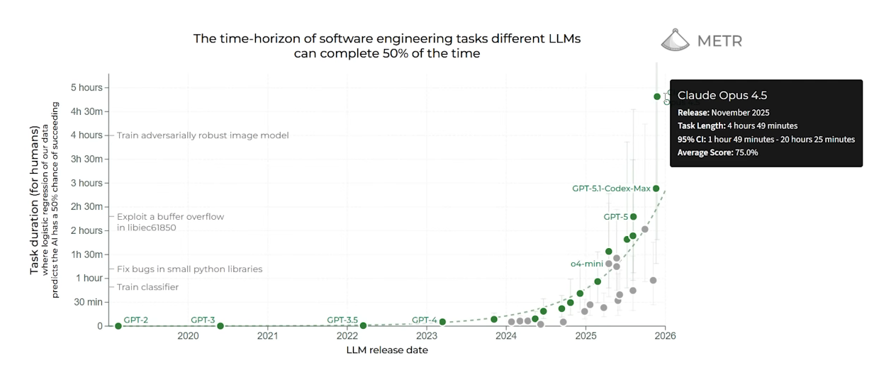
Why now ?
Notes:
And why is now, why this particular time,
Agent can handle job in the long time, instead of handle job in the sorttime like a minute or 40 50 minutes, the ability of technology is different, we see in the chart, claude can handle job nearly 5 hours, or GPT 5 can handle more than 2 hours, the human job can unnecessary, this is a strong of AI

Slide 17
Applications & Future of Agentic AI

Slide 18
Agentic AI Applications In Reality
Company
Verofax: AI agent with digital avatars
Maisa AI: startup develop AI workers
Ciroos: build AI system to automatically operation management IT and SRE
Quiq: customer service platform integration Agentic AI
Corporation
Microsoft: develop with Agent 365 system to automatically job and integration with Office 365 by AI agents
Wipro + Google Cloud: execute more than 200 Agentic AI solution for many major like : insurance, medical, manufacturing
Weber Shandwick + Google: build AI platform AI(HALO) to practice communication process in business

Slide 19
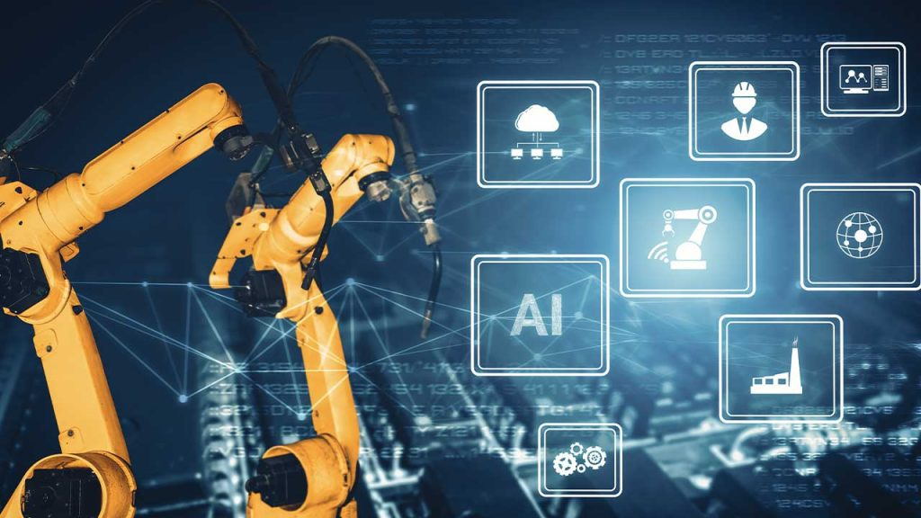
Agentic AI Applications In Semiconductor and Manufacturing
Check product quantity
Highly complex equipment
24/7 product lines
Strict quality requirements
Massive real-time data (SPC, MES, equipment log, yield reports
Agentic AI can operate as an intelligent digital supervisor across the factory

Slide 20
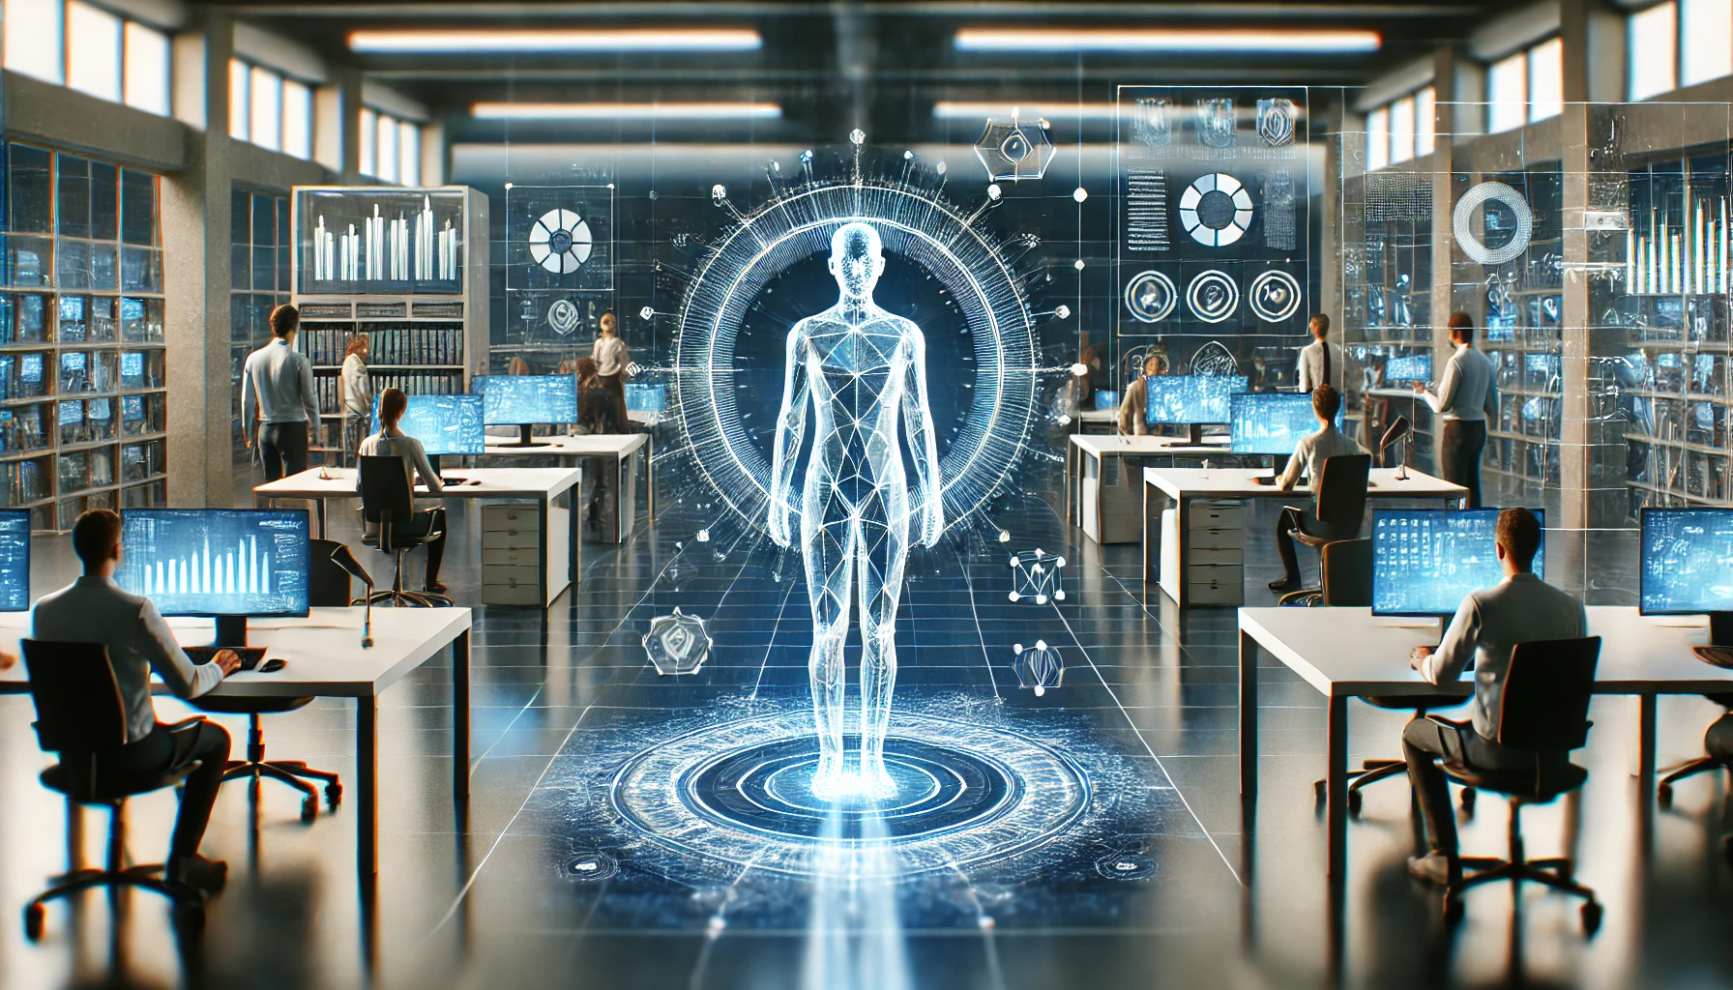
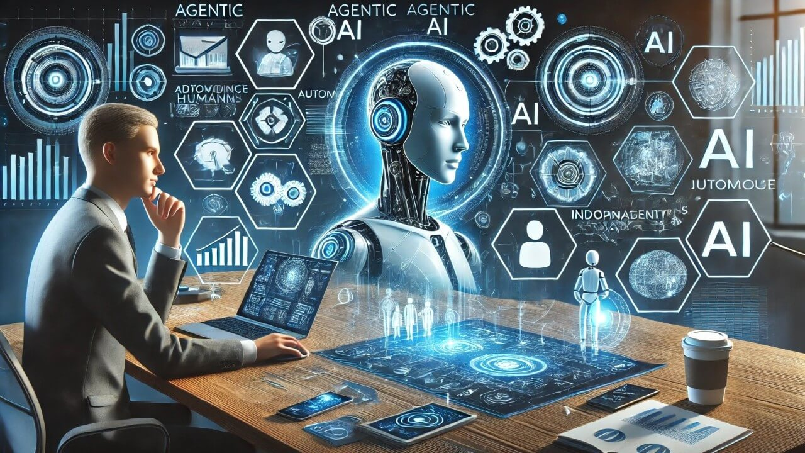
Monitor Storage Server / WAS Server
Intelligent Storage Optimization
Predicts SSD wear, bad block formation, and latency degradation
Automatically redistributes data between tiers based on workload
Balances IOPS across storage nodes to avoid hotspots
Smart Capacity Planning
Forecasts storage usage 30-90 days ahead
Suggests or automatically applies LUN/Volume provisioning

Slide 21
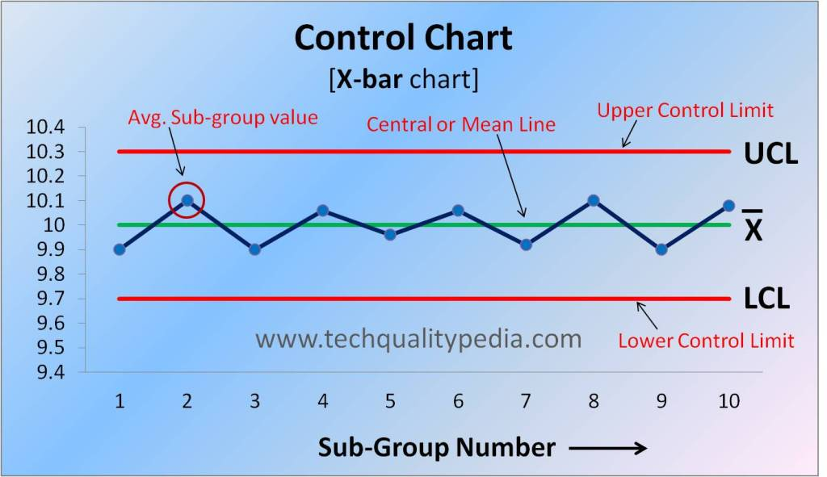
SPC
Autonomous SPC Analysis
Interprets SPC charts and detects trends before control limits are breached
Applies advanced rule checks autonomously
Identifies root causes by correlating params like temperature, pressure,..
Defect prevention & Quality Stability
Predicts process drift and recommends corrective actions
Minimizes scrap, reduces variability

Slide 22

Q&A

